Slide 1
GraphQL Schema Stitching
WITH

Slide 2

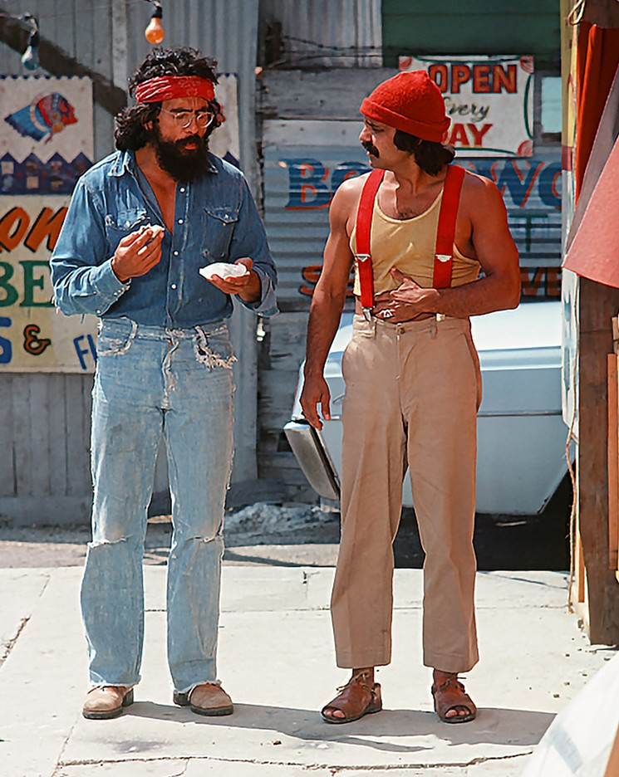
Who are we?

Slide 3

Who is this for?
Who is this for?

Slide 4
Demo

Slide 5



Slide 6

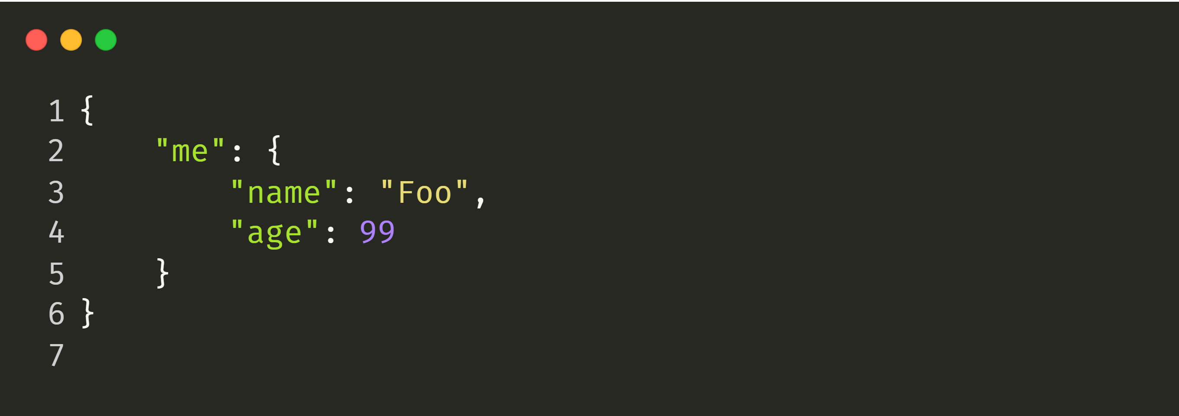

Slide 7
GET https://webservices.amazon.com/onca/xml?
Service=AWSECommerceService&
AWSAccessKeyId=mY-Sup3r-s3cr3!-k3y&
AssociateTag=12345&
Operation=ItemLookup&
ItemId=0316067938&
ResponseGroup=Reviews&
TruncateReviewsAt=256&
IncludeReviewsSummary=False&
Version=2013-08-01&
Timestamp=[YYYY-MM-DDThh:mm:ssZ]&
Signature=[Request Signature]
Notes:
https://www.ics.uci.edu/~fielding/pubs/dissertation/rest_arch_style.htm

Slide 10
What is GraphQL?

Slide 11
GraphQL
One Endpoint
No over- or under-fetching
Simplicity
Real-time
Predictability
No versioning
One Request
Type System
Documentation

Slide 12
Demo

Slide 13
Read | Query | GET
 |  | PUT, POST, PATCH DELETE
Events | Subscriptions | N/A
Write | Mutation | PUT, POST, PATCH DELETE
Operation | GraphQL | REST

Slide 14
Demo

Slide 15
Principles
One Graph
One Endpoint
One Request
Federated Implementation

Slide 16
How can we do microservices with that?

Slide 17


Slide 18

What is schema stitching?

Slide 19
The capability to merge multiple GraphQL schemas into one schema.

Slide 20

One GraphQL Query
query {
me {
messages {
# Hot Chocolate GraphQL
text
# Apollo Server
createdBy {
name
}
# Abritray REST Endpoint
views
likes
replies
}
}
}
Hot Chocolate Gateway
text
createdBy
views, likes, replies
{REST}
Apollo GraphQL
Hot Chocolate GraphQL
Arbitrary REST Endpoint
Raven DB
Mongo DB
SQL Server

Slide 21
Demo

Slide 22
Conclusion
Easy to use with minimal code in the gateway
Describe GraphQL with GraphQL
Merge multiple data source together
Adds complexity

Slide 23
Outlook

Slide 24
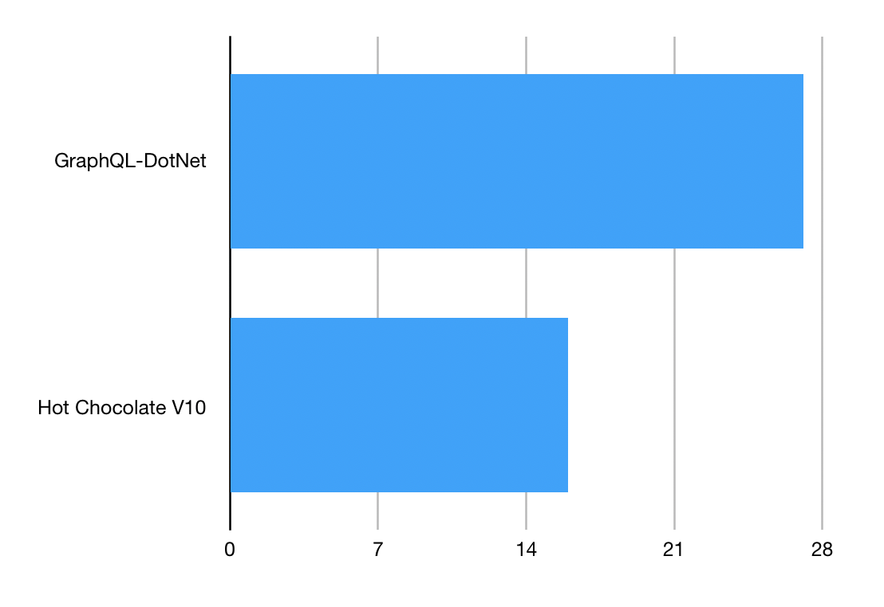
Speed:

Slide 25
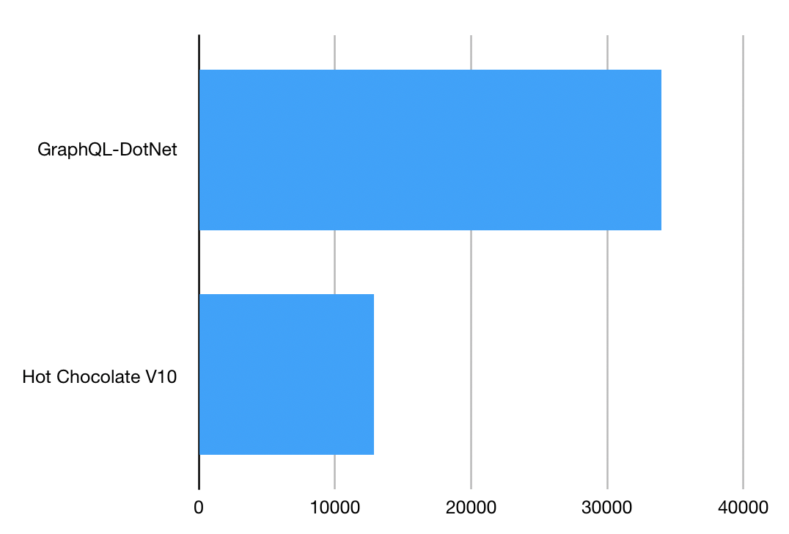
Memory:

Slide 26
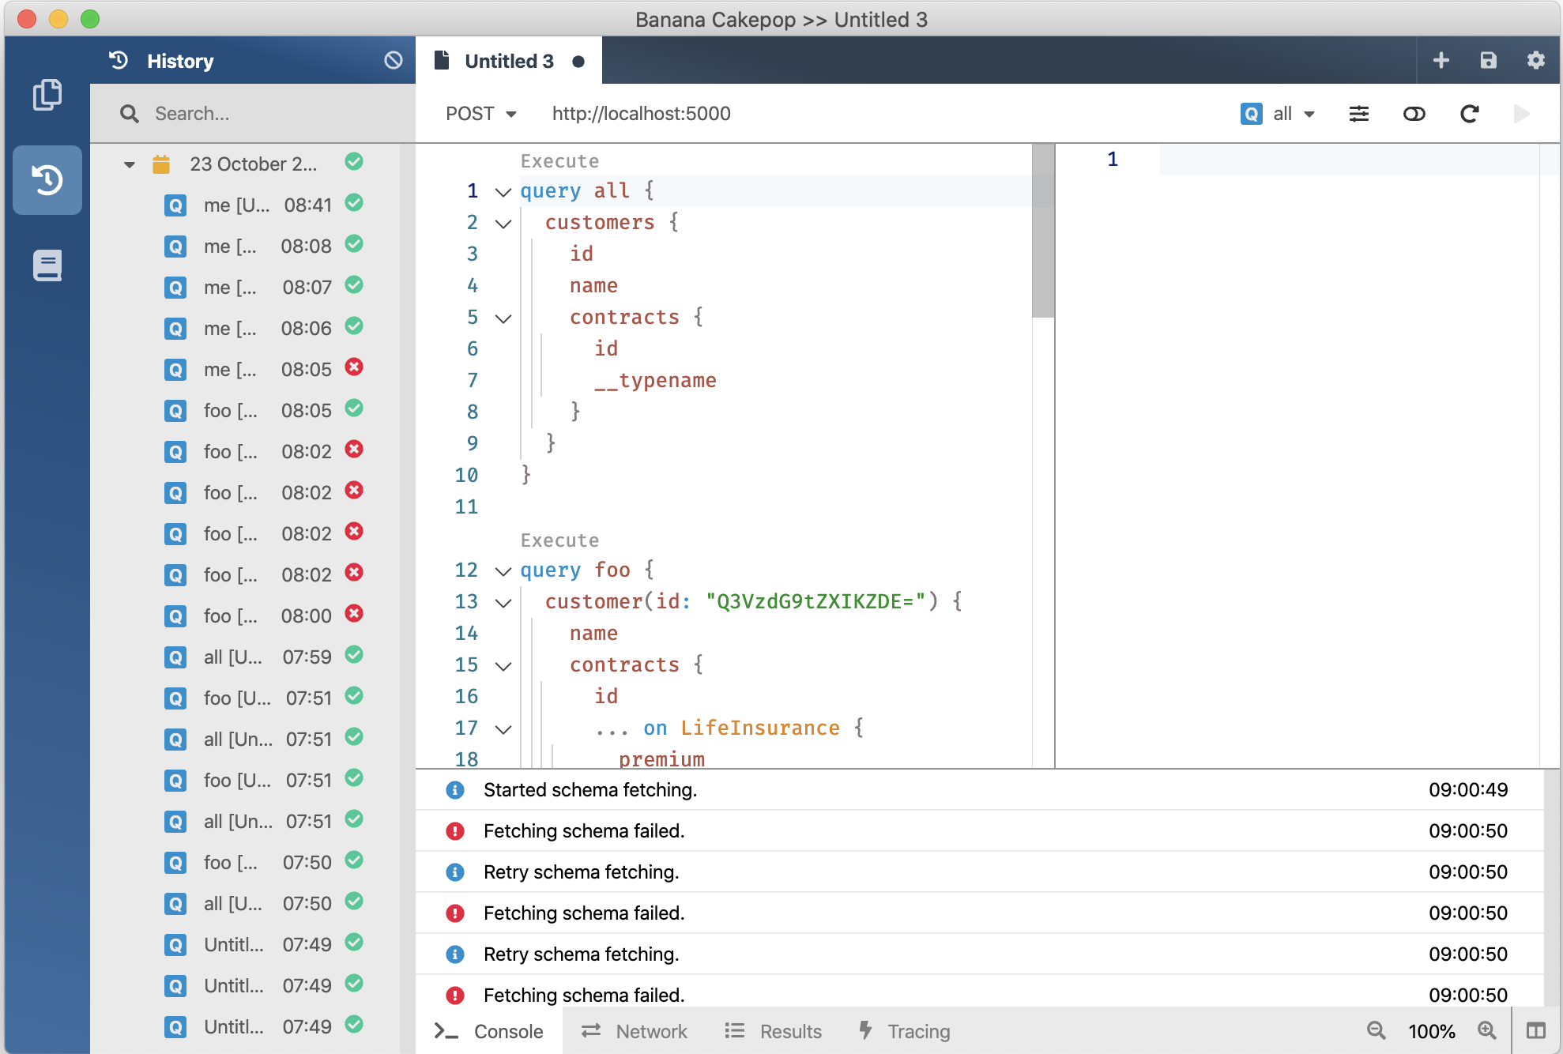
V10
GraphQL Gateway
V11 January 2020
V12 August 2020
GraphQL Client
GraphQL Server
Developer Tooling
Supports Blazor and Xamarin
Execution Plans @defer @stream
Schema Registry (Schema Change Tracking, CI Tools)
Automatic Database Mapping
GraphQL Analytics
Operations Manager (Execution Plan Store, Whitelisting, Client Registry)

Slide 27
Where do you find us?
https://hotchocolate.io
https://chillicream.com
https://github.com/ChilliCream/ApexVox2019
https://twitter.com/Chilli_Cream
https://github.com/ChilliCream

